Slide 1
Bedtime Routines for Baby
Child development

Slide 2
SIDS
Sudden Infant Death Syndrome
  The sudden, unexpected death of a baby under one year of age with no clear cause
  May be caused by drug use
  May be caused by other factors

Slide 3
Did you know?
SIDS is the leading cause of death in infants between 1 month and 1 year of age.
Most SIDS deaths happen when babies are between 1 month and 4 months of age.
Each year, about 4,000 infants die unexpectedly during sleep time, from SIDS, accidental suffocation, or unknown causes.
SIDS is not a risk for babies 1 year of age or older.

Slide 4
Reduce the risk of SIDS
Put babies to sleep on their backs
Avoid smoking both during pregnancy and after the baby is born
Avoid exposing the baby to smoke from others
Avoid illegal drugs while pregnant and nursing

Slide 5
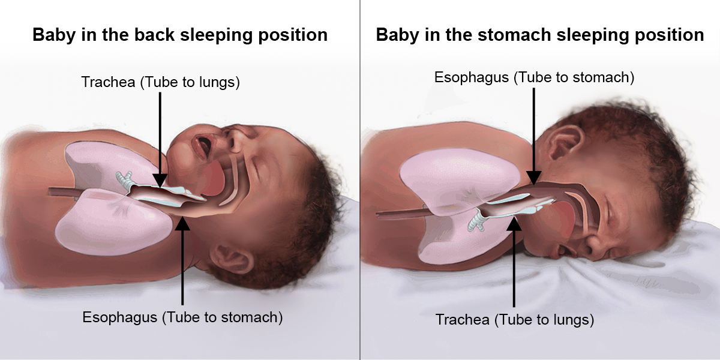
Why sleep on back?

Slide 6
Sleep
Essential for growth and development
Necessary for brain to work properly
Remove pillows, blankets, bumper pads, toys, etc. from crib
      Can cause suffocation
Be consistent with bedtime routines

Slide 7
How long will baby sleep?
Newborn
  Sleep a total of 12 to 20 hours a day
  Several naps throughout the day
3 months
  14-15 hours
  Longer naps but fewer throughout the day
4 months
  12-14 hours
  May start to sleep through night
  2 long naps during day

Slide 8
6 months
  12-14 hours a day
  6 hours of sleep through night
  Two long naps
12 months
  12 hours a day
  Sleeps 9 to 10 hours at night
  May take one or two naps at night

Slide 9


Slide 10

Where will baby sleep?
In nursery

Slide 11
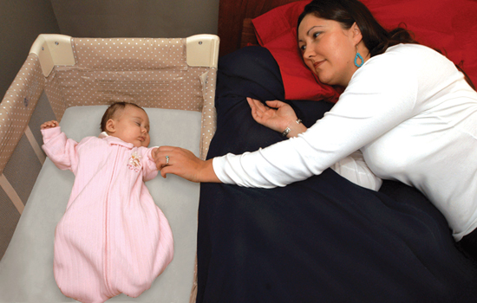
Room-sharing
Room sharing—keeping babies in sleep area in the same room where parents sleep—reduces the risk of Sudden Infant Death Syndrome (SIDS) and other sleep-related causes of infant death. If you bring your baby into your bed to breastfeed, make sure to put him or her back into a separate sleep area in your room when finished.

Slide 12


Other room sharing options

Slide 13


Sleep wear

Slide 14
Baby sleep myths

