Slide 1
Elements of Design
Taken from Housing and Interior Design
By: Evelyn Lewis and Carolyn Turner

Slide 2
Objectives
Summarize the characteristics of good design
Evaluate the use of the elements of design in residential and commercial interiors
Analyze the psychological impacts of the elements of design on people
Analyze the effects the elements of design have on aesthetics and function

Slide 3
Communication
Visual imagery
Nonverbal communication
The language of sight
The image communicates a feeling to you
Each room’s visual image communicates a certain personality or mood and can have a psychological impact on the room’s occupants
Design is the basis for this visual image
Understanding and creating good design requires knowing design characterizes and the elements of design

Slide 4
Design
The word design has many meanings
Interior designers refer to design as the entire process used to develop a specific project
One object, a room, or building
Design also refers to the product or result of the process.

Slide 5
Design Characteristics
Design has 3 characteristics:
Function
Construction
Aesthetics
Designers use all three guidelines in creating and evaluating any design.

Slide 6
Function
How a design works
A design’s function includes usefulness, convenience, and organization
Good design makes a product or room better or easier to use
Considers the needs of people using the item
Accommodates the ages, sizes, and physical abilities of the users
Successful functional design provides easy access for all people and eliminates barriers

Slide 7
Construction
Includes materials and structure
Materials are the different kinds of fabrics, woods, metals, plastics, or stones used to build a product or room
Choosing appropriate materials is necessary to support the room’s function
Consider design function, quality, initial cost, maintenance, environmental implications, and long-term costs when selecting materials
Must meet industry standards, government codes, and regulations

Slide 8
Construction
Structure refers to how the materials are assembled
Need to be safe, durable, and well made
Appropriate for the intended use
Must meet industry standards, government codes, and regulations

Slide 9
Aesthetics
Beauty, pleasing in appearance or effect
Each person has his or her own personal taste
Can be difficult to define
Good aesthetic design is pleasing to many people
Stimulate an emotion or communicate a message

Slide 10
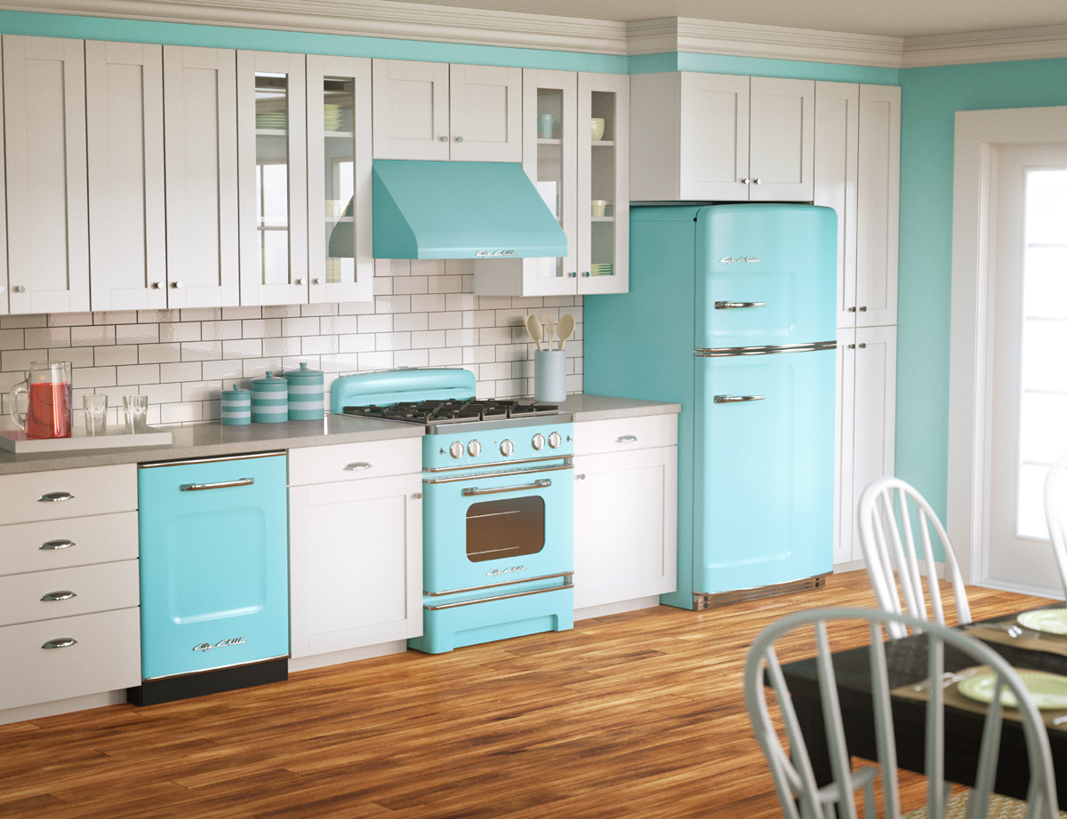
Elements of Design
Line
Form
Space
Mass
Texture
Color

Slide 11
Line
Most basic element
Form by connect two dots
Lines are very important to design
If you look around a room, you can see lines in many places
The legs of a table,
the frame of a window, or
the stripes on a chair
Show direction and cause the eyes to move from one point to another

Slide 12
Line
horizontal
Long and narrow
Connects two points
Leads the eye from one point to another
vertical
curved
diagonal

Slide 13
Horizontal Line
Parallel to the ground
Feelings of peace, relaxation, calmness, and restfulness
Associated with the sunset
Many home furnishings utilize horizontal lines
Mantels, bookcases, long sofas, shelving, etc.

Slide 14
Horizontal Line
Restful
Relaxing
informal

Slide 15
Horizontal

Slide 16
Vertical Lines
Perpendicular to the ground
Cause your eyes to move up and down
Suggests height, strength, dignity, formality, permanence, and stability
Appear in many home furnishings
Window treatments, wallpaper, decorative trims, grandfather clocks, armoires, tall mirrors, etc.

Slide 17
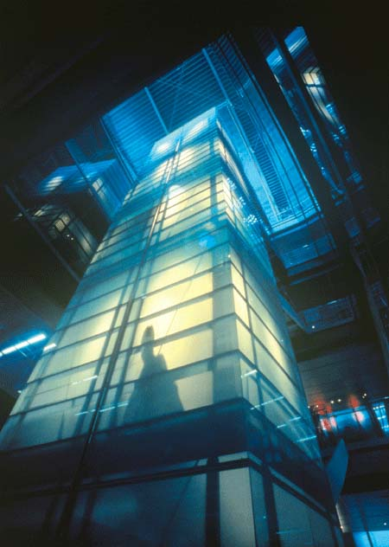
Vertical Line
Lends dignity and formality
Creates feelings of aspiration and ascension

Slide 18
Vertical

Slide 19
Vertical

Slide 20
Diagonal Lines
Lines that angle between horizontal and vertical lines
Communicate different levels of activity, ranging from a low- to high- level of energy
Depends on the degree of the angle and the total number of angles
Use of diagonal furniture placement in floor plans brings movement, interest, and excitement
Can also enhance conversational areas.

Slide 21
Diagonal Lines
Create a feeling of transition from one level to another
Appear in rooflines, cathedral ceilings, staircases, lampshades, and various fabrics and paintings

Slide 22
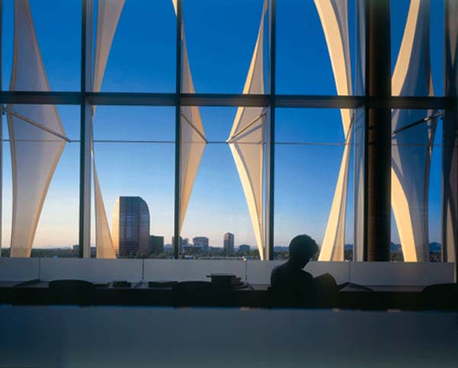
Diagonal Line
Active
Suggests movement

Slide 23
Diagonal

Slide 25
Curved Line
Part of a circle
Can take a free-form shape
Curved lines seem softer than straight lines
A circle or oval reflects organization, eternity, and uniformity
Slightly curved, free-form lines have a natural, soothing and flowing movement
Communicate softness, freedom, and openness

Slide 26
Curved Line
Upward – lifts and inspires
Horizontal – relaxed, denotes gentleness and femininity
Downward – sadness and seriousness
Small - playful

Slide 27
Curved

Slide 28
Straight lines

Slide 29
Using Lines in Interior Designs
By using different types of lines a space can appear larger, smaller, calmer, or busier
Repeating straight lines or curved lines can create a strong, intense statement
To create a more subtle and diverse look, combine various types of lines.
Low sofas can draw your gaze around the room and create the illusion of greater width.
By aligning the tops of picture frames you can create the effect of a continuous line.

Slide 30
Combination

Slide 31
What types of lines do you see here?

Slide 32
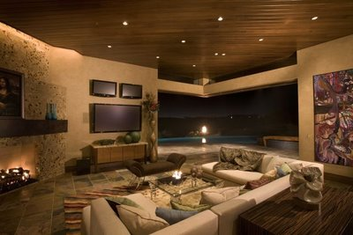
Describe the line used in this picture.

Slide 34
Form
The physical shape of objects
Outlines the edges of a three dimensional object and contains volume and mass
Also has height, width, and depth
Can have a great psychological impact on the feelings individual have when they enter a room or area

Slide 35
Realistic form
Looks very much like the real thing
Communicates a lifelike, traditional, and familiar feeling
Example: a chair has realistic form because of its specific form. Its is easily recognizable as a chair

Slide 36
Geometric form
Uses squares, rectangles, circles, etc. to create form
Communicates organization, order, planning, and a tailored look
Example: square table, round lampshades

Slide 37
Free Form
Random and flowing
Find it in nature
Plants, stones, wood
Does not have geometric design
Communicates sense of freedom
Untraditional, unfamiliar, and different from realistic form

Slide 38
Using form in Interior Design
Follow these guidelines
Form follows function
Related forms are more agreeable than unrelated forms
A gradual change in form smoothly directs the eyes

Slide 39
1st>Consider the function of an object first in developing the design concept
Then choose the form
Example: Chairs for a family room that lets people sit comfortable and relax
2nd>your eyes feel comfortable looking at similar forms
Example: square forms dominate in one room giving it a crisp, organized look

Slide 40
3rd>seeing an abrupt change in form or too many different forms together may be unpleasant and confusing
When form changes your eyes work harder to follow the different shapes
Sometimes the change in form can cause excitement

Slide 41
Form
Form describes the shape and structure of solid objects.
Form may be 2 or 3 dimensional.
2 dimensional would be walls and rugs (usually contain little or no depth)
3 dimensional would be chairs and other furniture
Large heavy objects such as pianos or sofas give a feeling of stability.
Their massive appearance adds a solid feeling to the room.
Placing several small objects together will create stability as well (such as 2 chairs and a table grouped together)
Designers are usually more concerned with apparent weight rather than actual weight.
Light colors pair with other light colors equal a lightness
Light colors paired with dark colors may add weight.

Slide 42
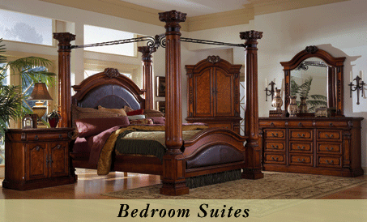
Which room appears to have more weight?

Slide 43
Space
Space refers to the area around a form
When discussing space, consider these two factors:
The size of the space
And the arrangement

Slide 44
Size of the Space
Height, length, and width often define the size of the interior space
The size affects who will use the space and how they will use it.
The size of a space can also communicate positive or negative feelings
Large space can communicate feelings of openness, grandeur, or freedom
Small spaces can make you feel cozy, intimate, or comfortable

Slide 45
Arrangement of Space
Evaluate the space and decide what design effects you want to achieve
You can achieve various effects by arranging the space differently
You can arrange space to make large spaces look smaller and small spaces look larger
To open and expand spaces, you can expand a window area, use mirrors, or remove walls
To create the feeling of cozy quarters, designers can divide the space into separate areas
Use area rugs, cluster furniture, etc.

Slide 46
Mass
Mass is the amount of pattern or objects in a space
It also refers to how crowded or empty a space appears

Slide 47
High Mass
High mass refers to a space that is visually crowded
Fabrics with a high mass design have a lot of pattern or lines
A room with high mass has many items in it and may look congested
High mass rooms may reflect a full, crowded or cluttered feeling
High mass may communicate an impression of formality and weightiness

Slide 48
Low Mass
Low mass refers to a space that is simple and sparse
Low mas designs use only the most essential furnishings
Low mass communicates clean and airy feelings
Used in design styles such as: Minimalism and Shaker styles

Slide 49
Using Mass
Designers can create a strong design statement by using either high or low mass
Blending high and low mass can create variety in a room design
Example: placing a low mass design above a high mass design creates a very open feeling in the room.
The two extremes may complement each other

Slide 51
Texture
Texture has to do with the way something feels or looks as though it would feel.
Texture often influences the way people feel in a room.
Flush rugs and furniture covered with soft fabric provides a sense of comfort and luxury, while nubby, rough materials convey a casual, relaxed feeling.
Smooth, hard surfaces give a clean, modern effect.

Slide 52
Tactile Texture
The way a surface feels to touch
You can see and feel the tactile texture
Example:
Stone wall: you can see the ridges, you can feel its roughness
Tactile textures can also be functional, such as those used in slip-resistant flooring

Slide 53
Visual Texture
Texture that you can see, but cannot feel
Find in wall coverings or pattern design in fabric
Plaid pattern in fabric has a visual texture although the tactile texture may still be smooth

Slide 54
Using Texture
Rough surfaces can create a more casual feeling
Smooth surfaces may communicate an elegant feeling
Polished stone or marble can communicate both elegance and strength

Slide 55
Terms to describe Texture
Ribbed rough crinkled smooth soft bumpy satiny silky fluffy hard flat abrasive nubby shines plush fuzzy ridged spikey course gritty slick

Slide 56
Using Texture
Heavy or rough textures absorb more light than smooth textures
They do not reflect light throughout a room, so the room looks smaller
Smooth surfaces makes small rooms look larger
The light reflects off the smooth surface, creating the illusion of a larger space

Slide 57
You can create variety by using both visual and tactile textures
When a designer uses more than one texture in a room, the room looks more interesting
Too many kinds of texture in one room may be a distraction

